Slide 1

PROJECT REPORT
Title of the Project
Bazaar – Shopping website
Course Code INT252
Submitted To
Kamalpreet Kaur
(31662)
School of Computer Science and Engineering

Slide 2
DECLARATION
We hereby declare that the project work entitled “Digital Waves” is an authenticrecord of our own work carried out as requirements of Project for the award of Bachelor of Tech degree in P132 from Lovely ProfessionalUniversity, Phagwara, during August to November 2024. All the information furnished in this project report is based on my own intensive work and is genuine.
Name of Student :Harsh Registration Number: 12205435
Roll NO: 39
Section: KM005
Date: 08-11-2024

Slide 3
CERTIFICATE
This is to certify that the declaration statement made by the students is correct to the bestof my knowledge and belief. He has completed this Project under my guidance and supervision. The present work is the result of his original investigation, effort and study. No part of the work has ever been submitted for any other degree at any University. The Project is fit for the submission and partial fulfillment of the conditions for the award of B. Tech degree in P132 from Lovely Professional University, Phagwara.
School of Computer Science and Engineering,
Lovely Professional University, Phagwara, Punjab.
Date 08-11-2024

Slide 4
TABLE OF CONTENTS
Sno. | Tittle | Page no.
1 | Introduction | 5
2 | Objective of the project | 7
3 | Functionality of the project | 10
4 | Methodologies used in the project | 13
5 | Future Scope of the Project | 16
6 | Snapshots | 22
7 | Projects codes
8 | Conclusion | 24
End of Content

Slide 5
INTRODUCTION
Introduction: Bazaar
The rapid growth of digital commerce has transformed traditional shopping into a seamless online experience, with e-commerce websites playing a pivotal role in connecting consumers with products at their fingertips. "Bazaar" is a modern e-commerce platform developed to offer users an intuitive, responsive, and secure shopping experience. Leveraging the MERN (MongoDB, Express.js, React, Node.js) stack, Bazaar is built to handle a range of e-commerce functionalities, making it a scalable and robust solution for both small and large-scale online retail businesses.
The primary focus of Bazaar is to enhance user engagement through an efficient and visually appealing front-end built with React and styled using CSS, ensuring that the platform is accessible across devices. The application’s backend, powered by Node.js and Express, manages data operations, user sessions, and ensures a smooth shopping experience from browsing to checkout. MongoDB, a NoSQL database, is employed to store and retrieve data, providing a flexible and scalable data solution for product information, user details, and order records.
An integrated payment gateway allows for secure and seamless transactions, catering to the growing need for privacy and trust in online shopping. Furthermore, Bazaar includes an admin panel to enable administrators to manage products, inventory, and orders efficiently. This panel serves as a central hub for content management and order fulfillment, giving businesses the tools to operate smoothly and focus on customer satisfaction.

Slide 6
Bazaar’s modular architecture ensures ease of future enhancements and maintenance, making it adaptable to evolving e-commerce trends. This report explores the design, technology choices, and development methodology that guided the creation of Bazaar, detailing the features and components that make it a competitive solution in the fast-paced e-commerce market.

Slide 7
Objectives of Project
The primary objective of the "Bazaar" e-commerce platform is to deliver an efficient, user-friendly, and secure online shopping experience. Through intuitive design and responsive performance, Bazaar aims to streamline the journey from product discovery to checkout, catering to a wide range of consumer preferences and behaviors. By leveraging the MERN stack, Bazaar provides a robust and scalable foundation, ensuring the application can adapt to the demands of growing user traffic and expanding product catalogs.
A key goal of Bazaar is to integrate secure payment processing, establishing consumer trust and simplifying transactions through a reliable gateway. This feature addresses privacy and security concerns, allowing users to make purchases with confidence. Additionally, the website’s responsive design ensures that users enjoy a consistent experience across desktops, tablets, and mobile devices, enhancing accessibility and engagement.
Another significant objective is to empower administrators with a comprehensive admin panel. The admin interface enables efficient product management, inventory tracking, and order fulfillment, reducing operational complexities. This centralized control enhances the business’s ability to deliver a high-quality, dependable shopping experience.
Overall, Bazaar is designed with modularity and scalability in mind, making it adaptable to future business needs and emerging e-commerce trends. This project aspires to not only meet the basic functionality of an e-commerce website but also to exceed user expectations in usability, performance, and security. Through careful planning and execution, Bazaar is set to offer a complete and versatile platform for modern online retail.

Slide 8
User-Friendly and Secure Shopping Experience: Design an interface that is easy to navigate, offering a streamlined path from product discovery to checkout. The site aims to make shopping enjoyable and efficient, which encourages users to return.
MERN Stack for Scalability and Performance: Use MongoDB, Express, React, and Node.js to create a responsive and reliable platform capable of handling high traffic and a growing product catalog. This stack enables Bazaar to perform smoothly under heavy user loads.
Streamlined Shopping Journey: Implement features that guide users intuitively through product searches, browsing, and checkout, minimizing friction and enhancing satisfaction.
Secure Payment Gateway Integration: Incorporate a reliable payment gateway to protect user transactions and build trust. Secure payment processing addresses user concerns about data privacy and makes online purchases safe.
Responsive Design for Multi-Device Access: Ensure that the website is accessible and functions seamlessly on desktops, tablets, and mobile devices, providing a consistent experience across all screen sizes.
Comprehensive Admin Panel: Include an admin interface that allows easy management of products, inventory, and orders, reducing the administrative workload and improving operational efficiency. This empowers businesses to manage the platform effectively.
Modularity and Adaptability: Design the application with a modular structure, enabling easy updates and adaptability to new e-commerce trends or business needs.
Enhanced Usability, Performance, and Security: Aim to exceed basic e-commerce standards, ensuring that Bazaar is not only functional but also exceptional in its reliability, speed, and security for both users and administrators.

Slide 9
Drive Measurable Business Growth
Ultimately, the purpose of digital marketing is to drive business growth. Digital Waves provides businesses with strategies and tools that improve brand recognition, attract customers, and increase sales. By implementing targeted digital marketing strategies and tracking their effectiveness through analytics, users can understand their impact and make data-driven adjustments. This objective focuses on tangible results, helping businesses grow their online presence and meet their goals in a measurable way, whether that’s through higher website traffic, more conversions, or improved customer retention.
Encourage Innovation in Marketing Practices
Digital marketing is constantly evolving, and innovation is key to staying ahead. Digital Waves encourages users to explore creative approaches to marketing, whether it’s experimenting with new content formats, leveraging emerging platforms, or adopting innovative technologies like augmented reality. By fostering a spirit of creativity, we aim to inspire users to think outside the box and adapt to changes in the digital landscape. This objective is about pushing boundaries and exploring possibilities, ensuring that users are prepared for the future of digital marketing.

Slide 10
Functionalities of Project
1. User Management
User Registration and Login: This feature allows new users to create accounts and existing users to log in securely. By maintaining a user profile, it can store essential details such as addresses and order history, improving the user experience during future visits.
Authentication and Authorization: This ensures that only registered users can access specific features, like making purchases. Security protocols are implemented to protect user data and prevent unauthorized access. It includes role-based access, where users have different access levels compared to administrators.
2. Product Management
Add, Edit, and Delete Products (Admin): Admins can manage the product catalog by adding new products, editing existing ones, or removing items from the catalog. This allows the business to keep its inventory up-to-date and respond to demand changes or product availability.
Product Listings and Details (User): Users can browse through the catalog and view details for each product, such as descriptions, prices, ratings, and images. This feature is crucial for providing users with the information they need to make informed purchasing decisions.
3. Order Management
Order Placement and History (User): Users can add items to their cart, proceed to checkout, and place orders. Once an order is placed, users can view their order history, track order status, and check order details.
Order Tracking and Management (Admin): Admins can view and update order statuses, such as marking orders as "Processed," "Shipped," or "Delivered." This helps keep users informed about their order status, ensuring transparency in the order fulfillment process.

Slide 11
4. Payment Integration
Secure Payment Gateway: The integration of a payment gateway (e.g., Stripe, PayPal) allows users to make online payments in a secure environment. The gateway handles transactions securely, ensuring the protection of sensitive data (such as credit card information) through encryption and secure transmission.
Transaction Management: This includes handling successful payments, payment failures, and providing users with transaction receipts. A seamless payment process builds user trust and encourages more frequent purchases.
5. Admin Panel
Dashboard and Analytics: The admin panel provides an overview of critical metrics, such as sales volume, inventory levels, and user activity. These insights help administrators make informed business decisions, adjust inventory, and target specific marketing efforts.
User, Product, and Order Management: Admins can manage users by deactivating or reactivating accounts, updating user roles, and ensuring site security. They can also oversee product listings and order processing, making the admin panel a central control hub for the business.
6. User Interface
Responsive Design: Using React and CSS, the platform is designed to be responsive, ensuring it works well on various devices, including desktops, tablets, and mobile phones. This improves accessibility, allowing users to shop from anywhere, on any device.
Intuitive Navigation: The interface is designed to be easy to navigate, enabling users to quickly find products, access their cart, and manage their accounts. This improves the overall user experience, making the platform more engaging and user-friendly.

Slide 12
7. Database Management
MongoDB for Data Storage: MongoDB, a NoSQL database, is used to store all the essential data, including user profiles, product information, and order records. MongoDB’s document-oriented structure is flexible, allowing for quick updates and scaling as the website grows.
Data Retrieval and Management: Efficient data retrieval ensures that users can quickly access product information, order statuses, and other relevant details. MongoDB’s flexibility also supports indexing, which enhances the platform’s performance and search capabilities.

Slide 13
Methodology used in Project
When developing a project using ReactJS, Tailwind CSS, Lottie Files, Remix Icons, JavaScript, and Gemini API for a chatbot, the following methodology can be employed to ensure a systematic and efficient approach to building the web application:
Project Planning & Requirements Gathering
• Understanding the Scope: Define the project goals, objectives, and core functionalities (e.g., building a chatbot interface, responsive design, seamless user experience).
• Target Audience: Identify who the chatbot will serve, ensuring the design and functionality align with user needs.
• Technology Stack Selection: ReactJS for front-end, Tailwind CSS for styling, Lottie Files for animations, Remix Icons for vector-based icons, JavaScript for dynamic interactions, and Gemini API for chatbot interactions.
UI/UX Design & Prototyping
• Wireframing: Use wireframing tools like Figma or Adobe XD to map out the structure of the application. Design the user interface of the chatbot and website with attention to usability and visual hierarchy.
• Component Design: Focus on creating reusable UI components in ReactJS (e.g., buttons, input fields, chat bubbles).
• Animation & Icons: Choose or create animations with Lottie Files to improve user engagement. Use Remix Icons for vector icons that are lightweight and customizable.

Slide 14
Setting Up the Development Environment
• ReactJS Setup: Initialize the ReactJS project using Create React App or Next.js for more advanced routing and SSR capabilities.
• Tailwind CSS Setup: Integrate Tailwind CSS into the project to rapidly style the components. Configure tailwind .config.js to customize the utility classes as needed.
• Lottie Integration: Install Lottie React library to load and render Lottie animation files (e.g., animations for chatbot interactions or greetings).
• Remix Icons Integration: Install Remix Icons for easy access to high-quality, scalable icons. Icons are often used for user interaction, such as sending a message or closing the chat window.
.
Development Process
MongoDB: Stores user profiles, product catalogs, and order details. Its flexible, document-based structure supports scalable and efficient data management, ideal for dynamic e-commerce data.
Express.js: Acts as the backend framework, creating RESTful APIs to manage data operations and user authentication, ensuring secure and efficient communication between the server and client.
React: Builds the interactive frontend, allowing users to browse products, manage carts, and check out. Its responsive design provides a seamless shopping experience across different devices.
Node.js: Runs the backend environment, handling multiple requests simultaneously. It enables efficient server-side processing, including order handling, user authentication, and payment gateway integration.

Slide 15
Deployment
• Deployment Platform: Deploy the web app using services like Netlify, Vercel, or GitHub Pages for quick deployment of static React applications.
• Continuous Integration/Continuous Deployment (CI/CD): Set up CI/CD pipelines to automate the process of testing and deployment using tools like GitHub Actions or CircleCI.
• Monitoring: Implement error tracking tools like Sentry to monitor potential issues after deployment and gather feedback for improvements.
Maintenance & Updates
• Bug Fixes: Continuously monitor for bugs or issues that arise after deployment, especially in chatbot interactions.
• User Feedback: Collect feedback from users to improve the user interface, chatbot responses, and overall experience.

Slide 16
Future Scope of the Project
The future scope of the project involving ReactJS, Tailwind CSS, Lottie Files, Remix Icons, Gemini API (for chatbot), and JavaScript can be expanded in several directions, depending on user needs, technological advancements, and business goals. Below are some potential areas for future development:
1. Enhanced Chatbot Capabilities
• Natural Language Understanding (NLU): Improve the chatbot’s ability to understand complex queries by integrating more advanced AI models like GPT-based models (e.g., GPT-4 or Gemini API’s future versions). This will allow for more nuanced and dynamic conversations.
• Multilingual Support: Add the ability for the chatbot to understand and respond in multiple languages, making the application more accessible to a global audience.
• Voice Interaction: Integrate speech-to-text and text-to-speech capabilities for voice-based interactions, allowing users to talk to the chatbot rather than typing.
• Sentiment Analysis: Implement sentiment analysis to allow the chatbot to detect the mood or tone of the user (positive, negative, neutral) and adapt its responses accordingly.
• Personalization: Introduce user-specific personalization, such as remembering past interactions, preferences, or recommending actions based on previous conversations.
2. Advanced UI/UX Enhancements
• Custom Animations: Create custom animations using Lottie Files and integrate them with chatbot actions, such as reaction animations, transitions, or displaying dynamic content like product recommendations.

Slide 17
Interactive UI Elements: Enhance the user interface by adding interactive components like carousels, accordions, modal windows, or interactive data charts that can be displayed through the chatbot.
• Gamification: Introduce gamification elements like quizzes, challenges, or reward systems within the chatbot interface to engage users and keep them interacting.
• Dark Mode/Light Mode: Implement a dark mode option for users to toggle between dark and light themes for better accessibility and user comfort.
3. Integration with Other Services & APIs
• Third-Party Integrations: Integrate the chatbot with third-party APIs such as CRM systems, payment gateways, or calendar services to offer more functionality (e.g., booking appointments, processing payments, or managing contacts).
• Social Media Integration: Allow users to connect with social media platforms (Facebook, Twitter, Instagram) through the chatbot for a more seamless customer experience, such as retrieving social media messages or posting on behalf of users.
• E-commerce Integration: Connect the chatbot with e-commerce platforms (e.g., Shopify, WooCommerce) to facilitate purchases, product recommendations, or order tracking directly through the chat interface.
4. User Analytics & Reporting
• Advanced Analytics: Integrate advanced analytics to track user interactions with the chatbot, such as conversation flow, user engagement, and common queries. Use this data to optimize the chatbot’s responses and design.
• A/B Testing: Implement A/B testing for various chatbot features (e.g., message types, response time, animations) to analyze which version provides the best user experience.
• Customizable Reports: Enable users or administrators to generate custom reports based on chatbot interactions, usage metrics, or customer satisfaction ratings.

Slide 18
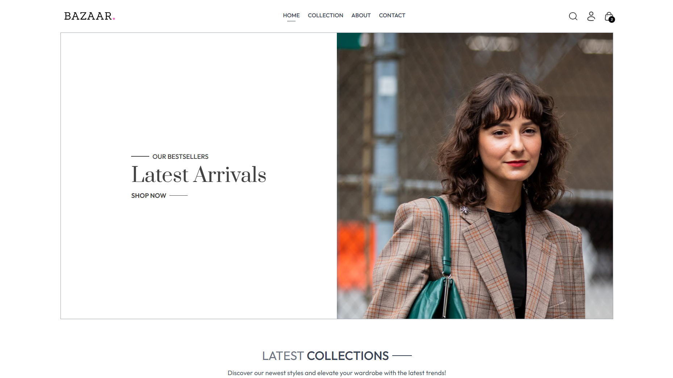
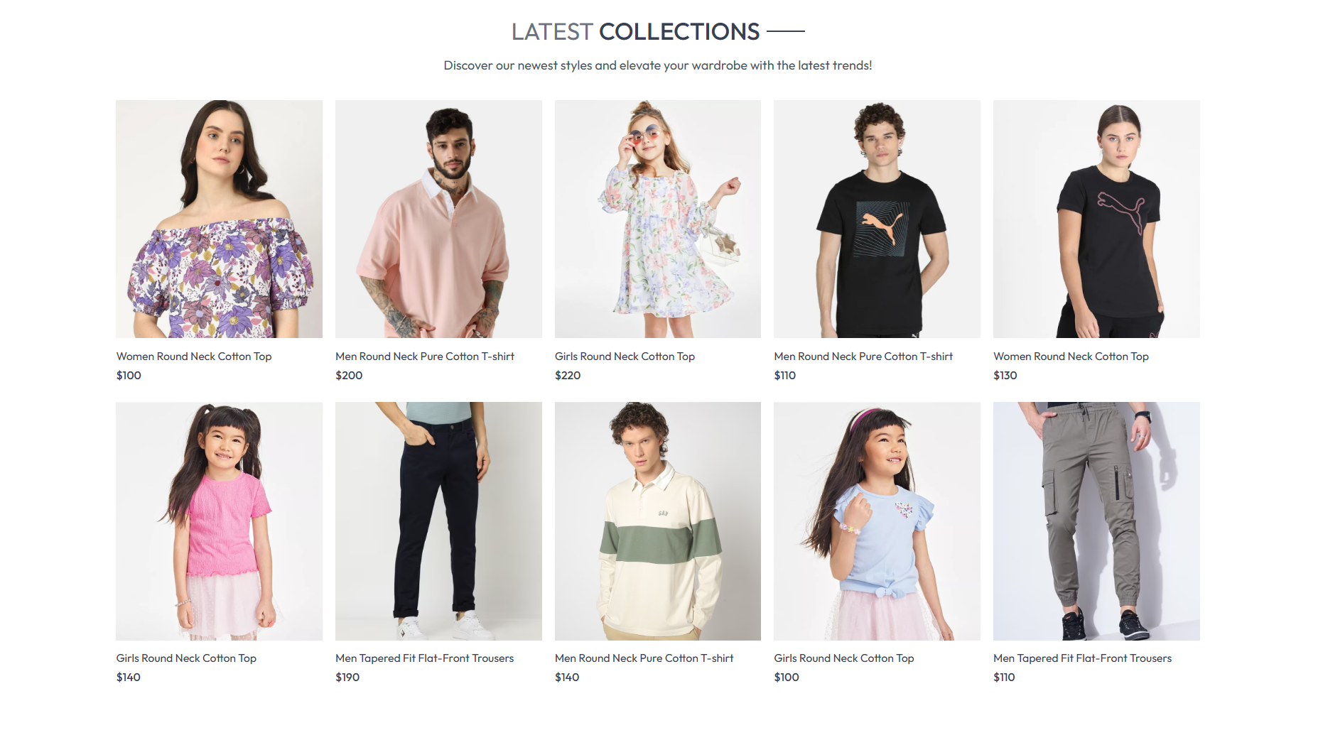
Snapshots

Slide 19
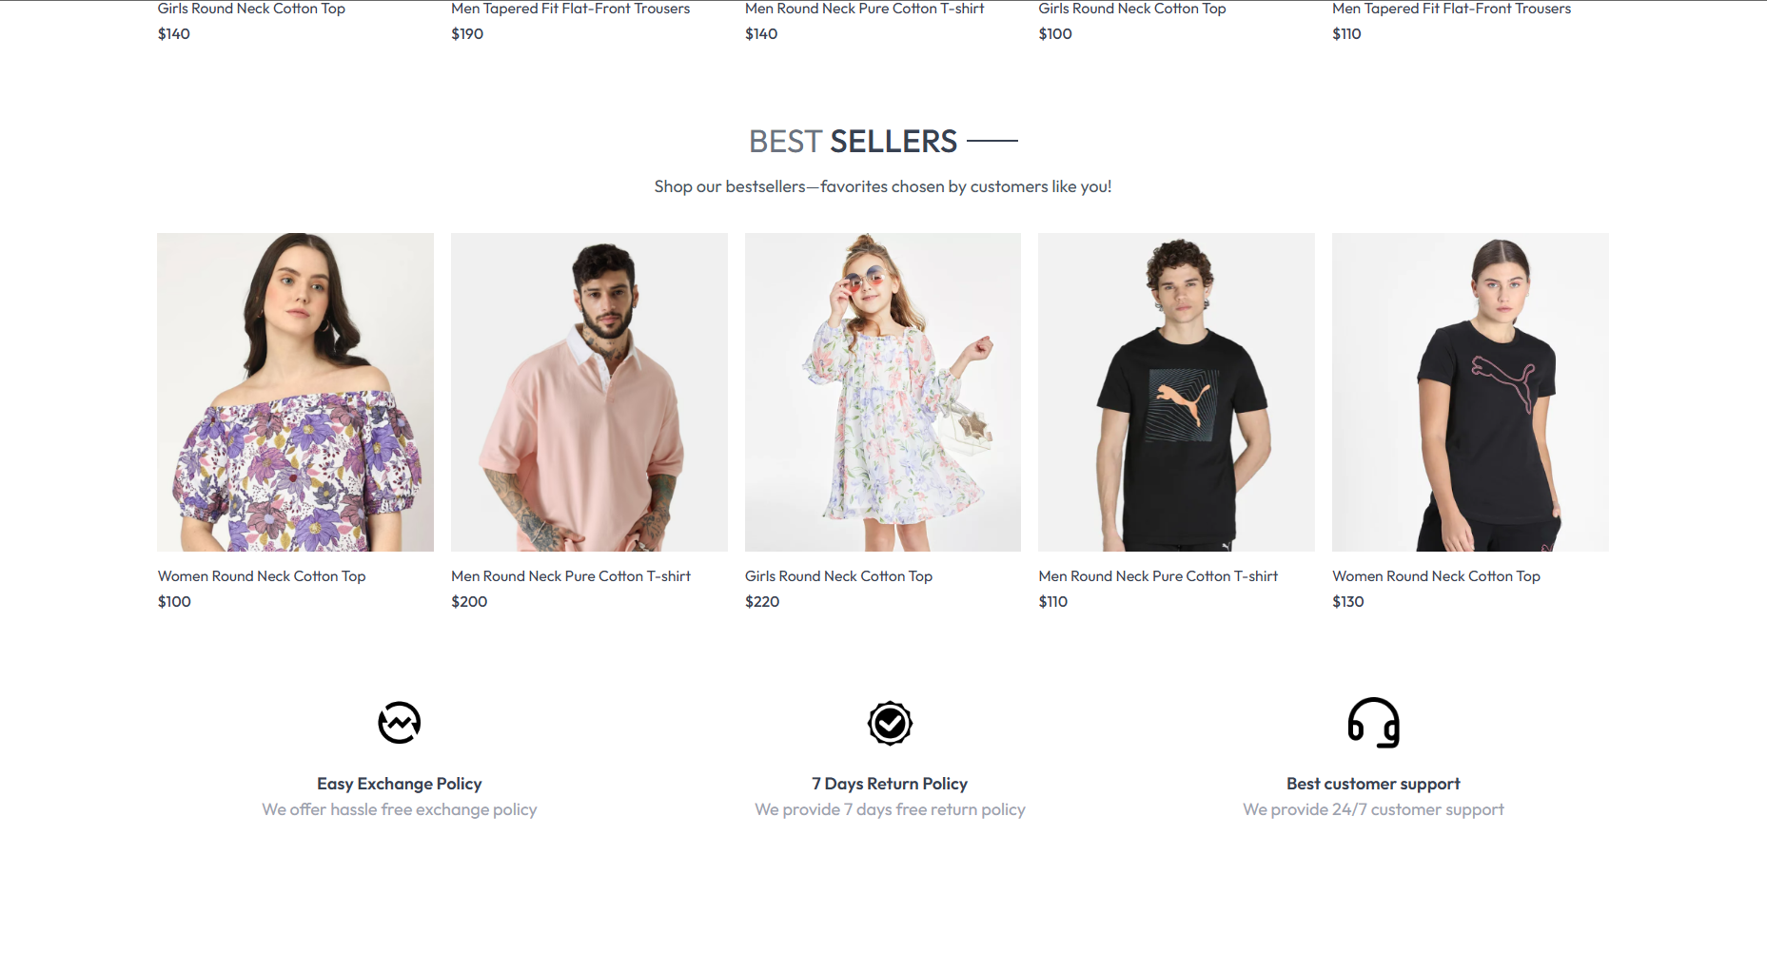
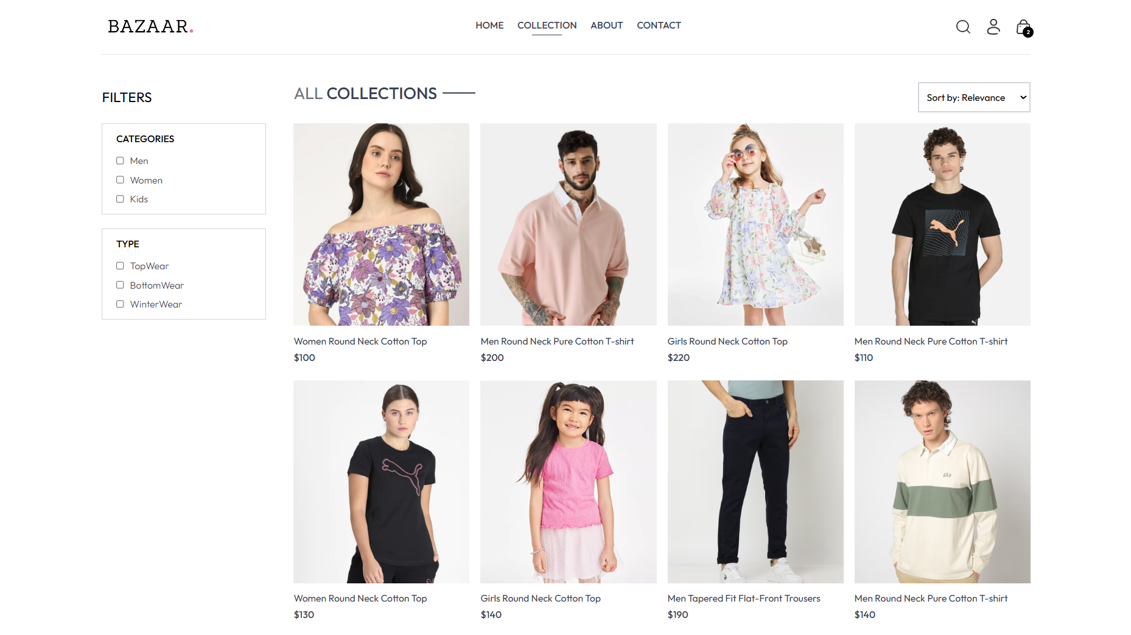

Slide 20
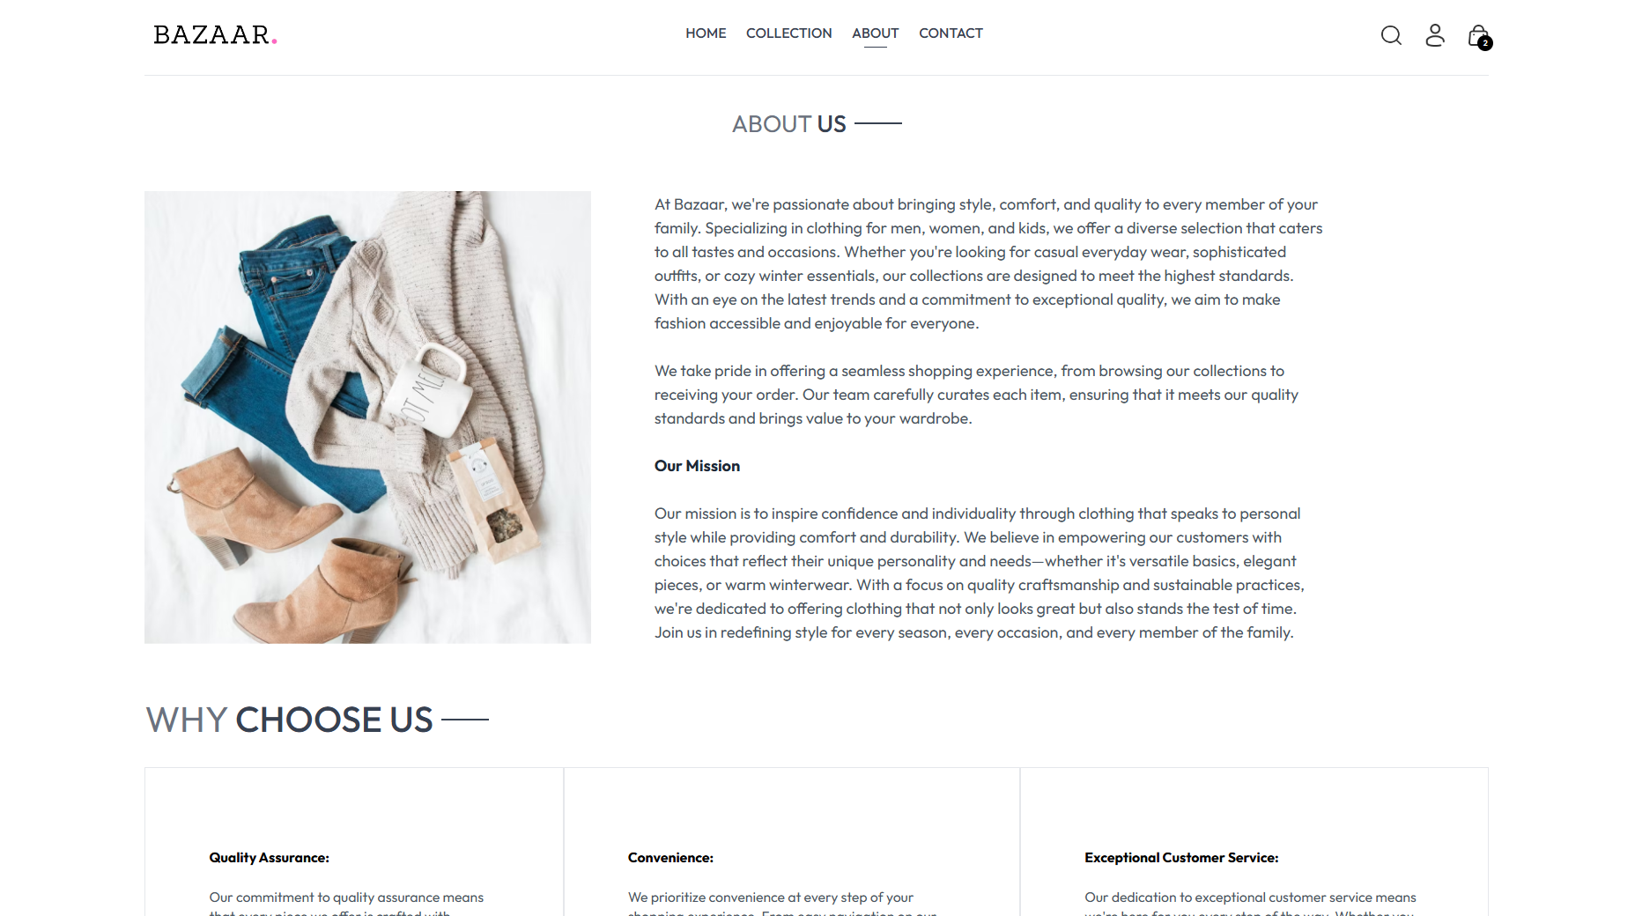
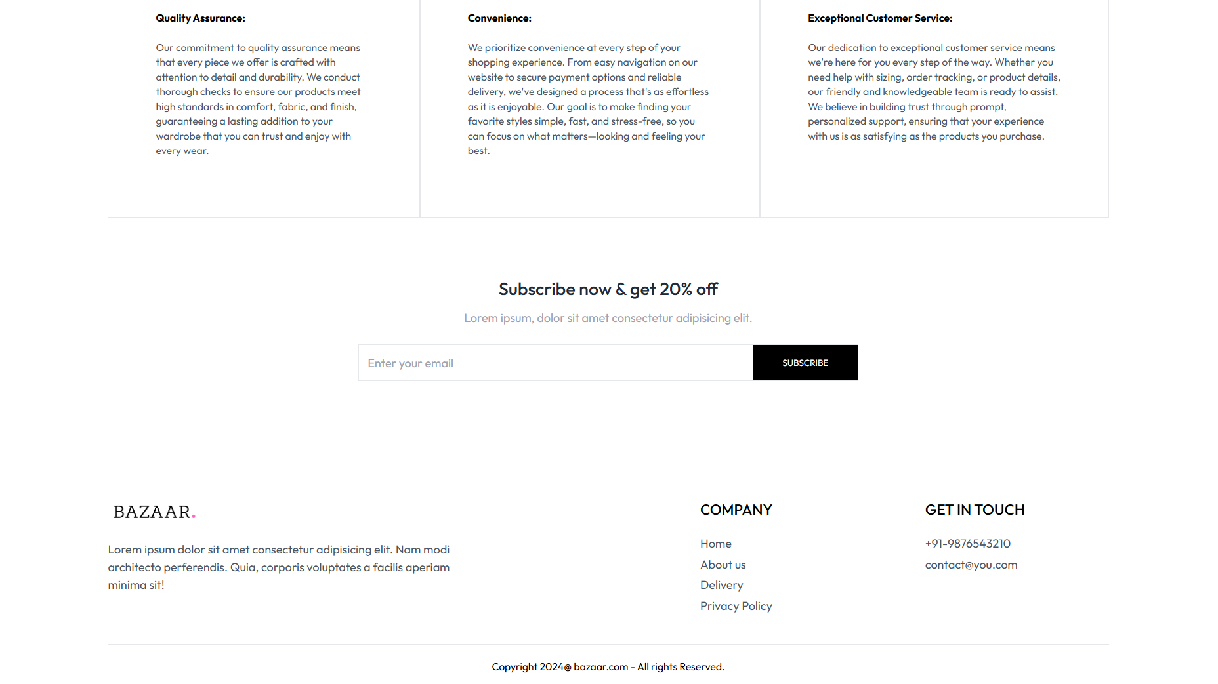

Slide 21
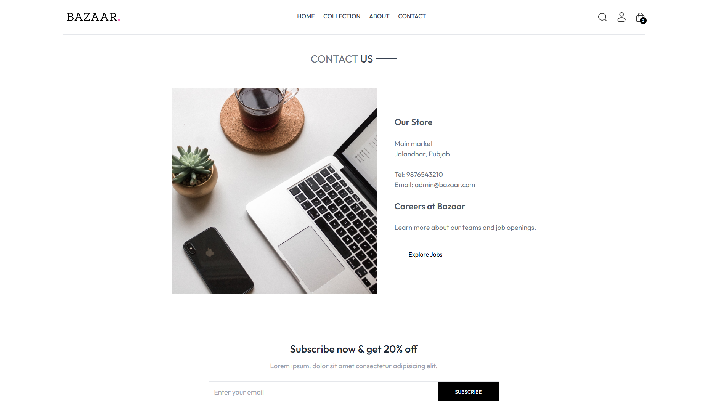
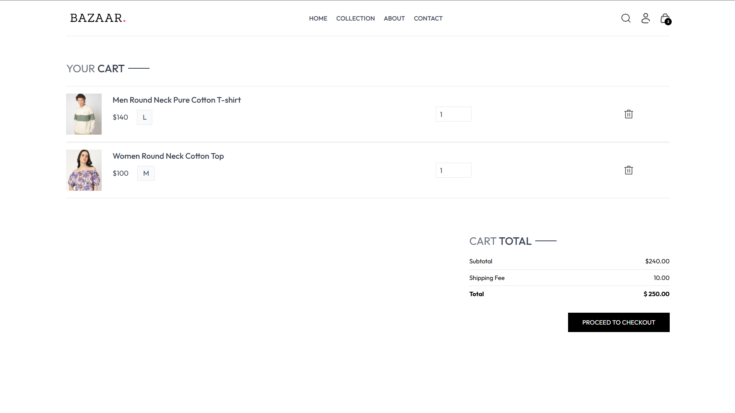

Slide 22
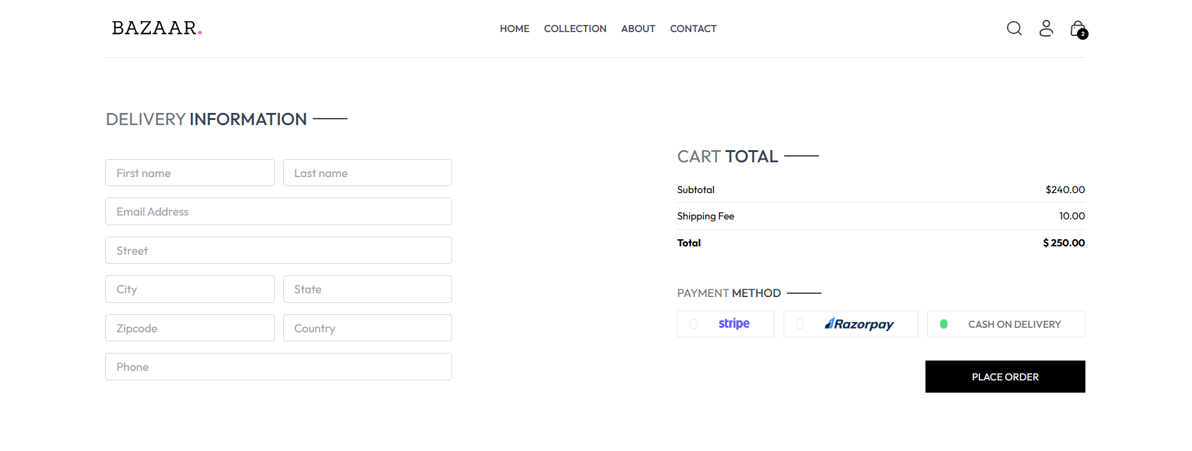
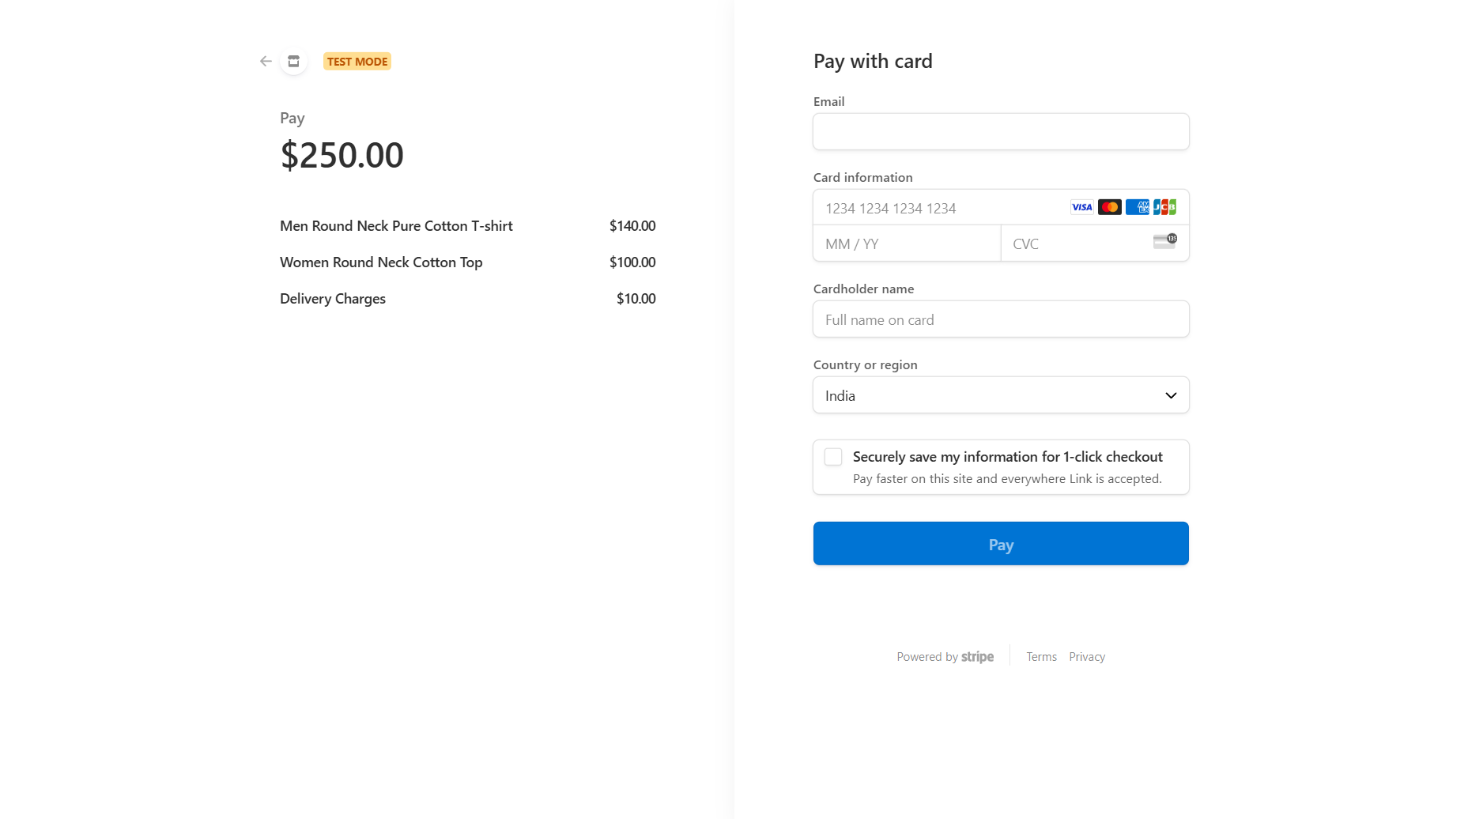
Payment Gateway : Stripe

Slide 23
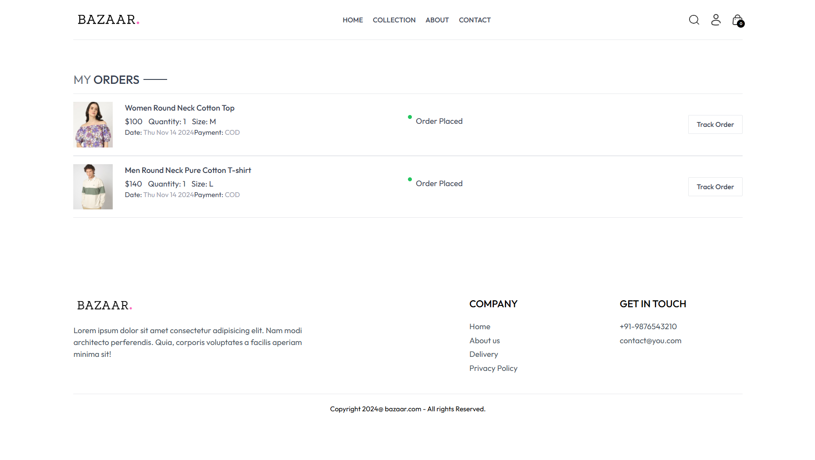
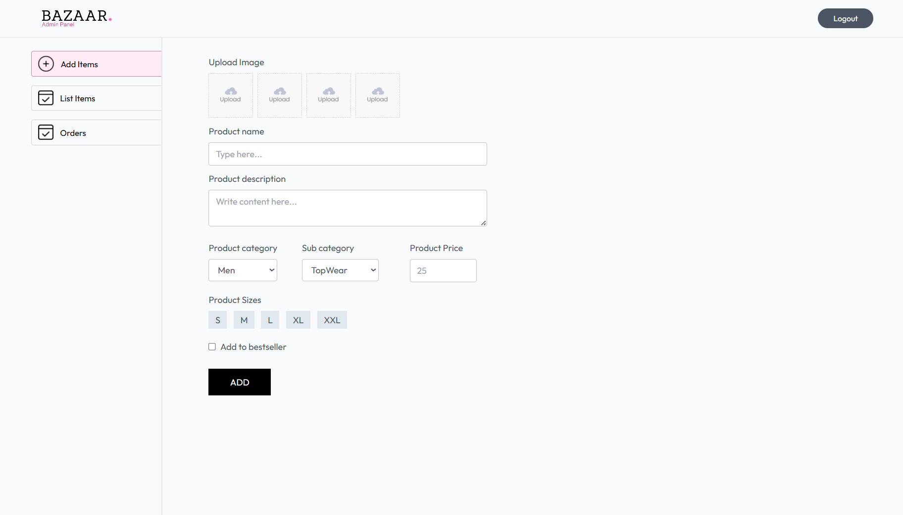
Admin Panel: Images

Slide 24
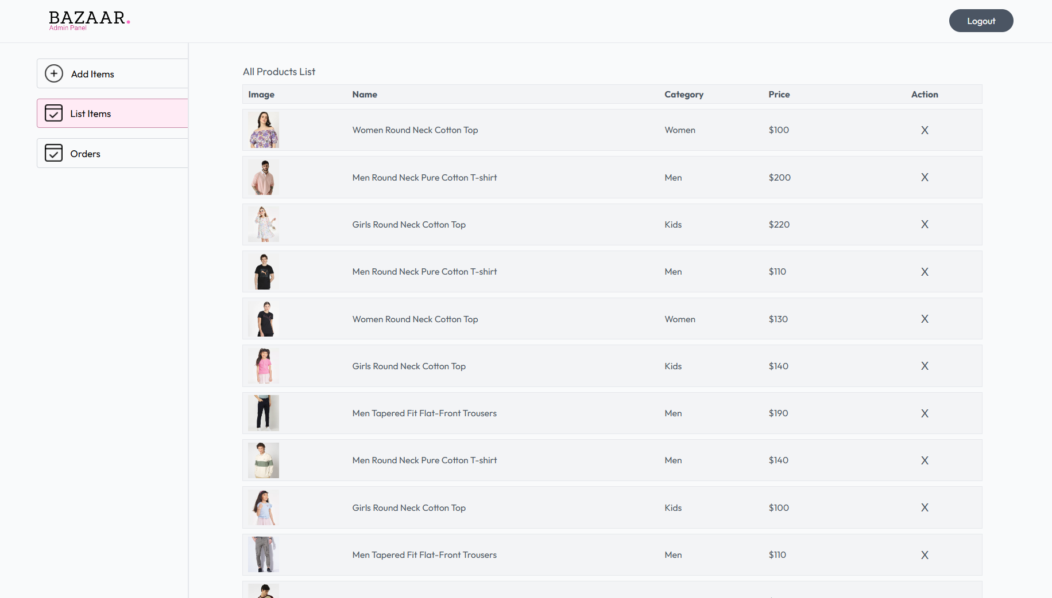
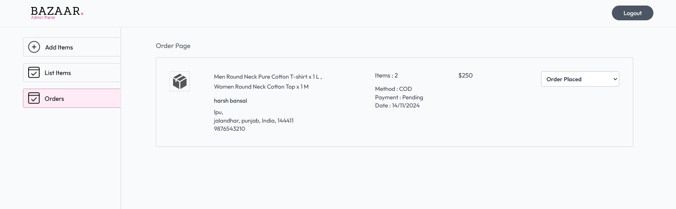

Slide 25
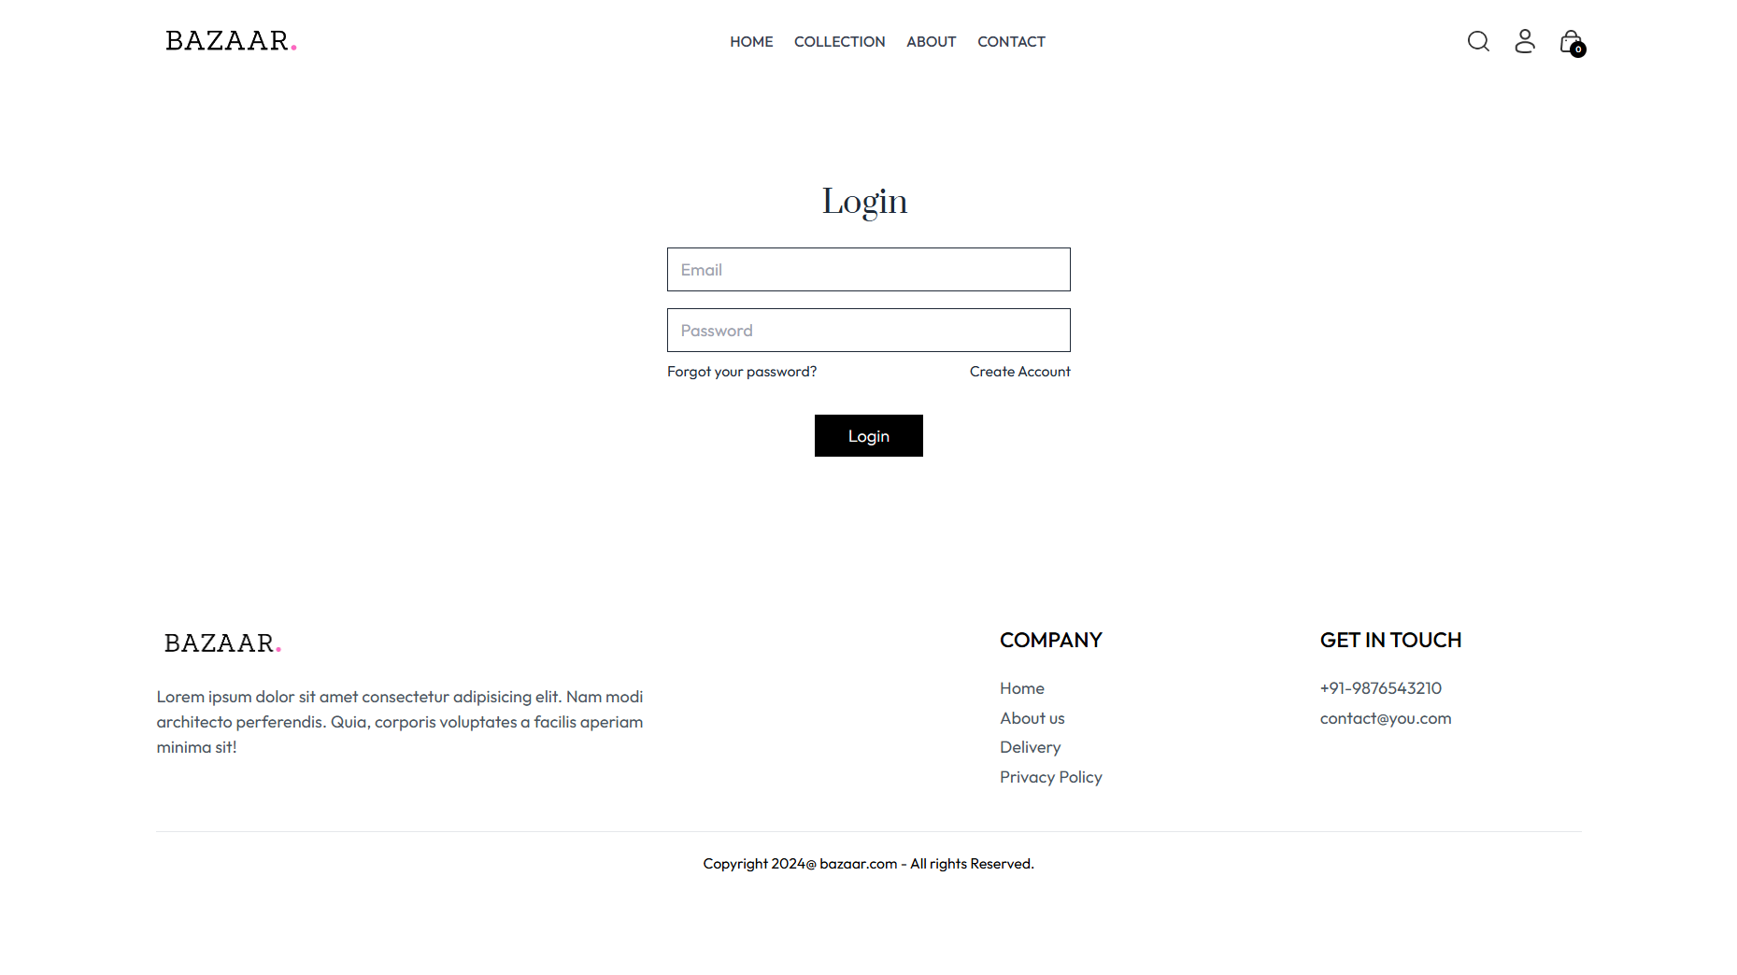
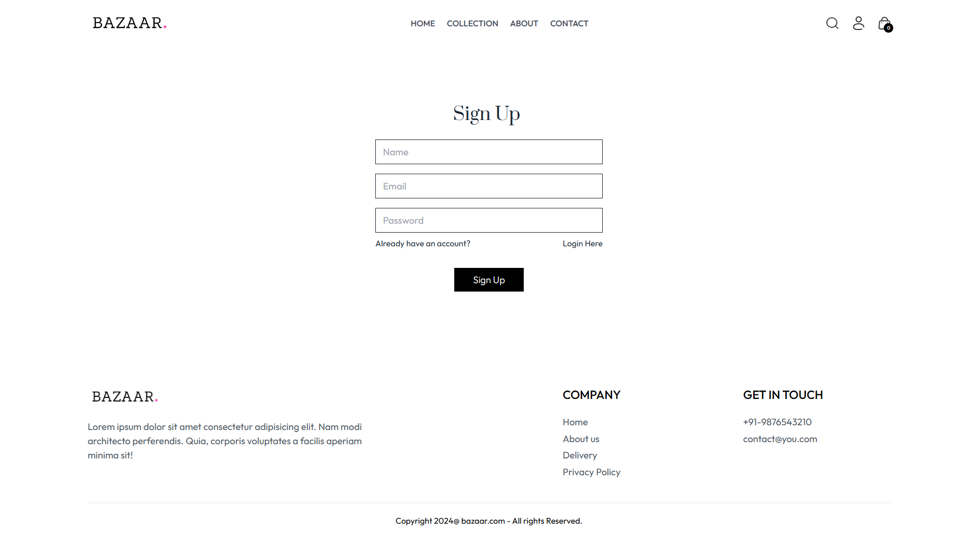

Slide 26
Conclusion
The "Bazaar" e-commerce project is a robust demonstration of how the MERN stack can be used to build a scalable, dynamic, and user-friendly online shopping platform. Using MongoDB, Express.js , React, and Node.js, this project provides a seamless shopping experience, enabling users to browse products, add items to their cart, and place orders efficiently.
MongoDB serves as the database, allowing flexible storage for essential data like user profiles, product details, and order histories. Its document-oriented structure provides scalability, enabling the platform to grow as the product catalog and user base expand. Express.js is utilized as the backend framework, handling API requests, authentication, and data processing. This enables smooth interaction between the front end and back end, ensuring efficient data flow and server-side functionality.
React is used to build an intuitive and responsive user interface, creating an engaging shopping experience across devices. Its component-based architecture allows for reusable UI components, improving performance and facilitating a fast, interactive user experience. Node.js serves as the runtime environment for executing JavaScript on the server side, handling concurrent requests, such as order processing and payment integration, with speed and efficiency.
The platform includes essential e-commerce features such as secure user authentication, payment gateway integration, and an admin panel for managing products, orders, and users. This provides administrators with the necessary tools to maintain and update the platform, ensuring smooth operation and data security.
In conclusion, "Bazaar" fulfills the core requirements of a modern e-commerce system, providing a comprehensive foundation that can be expanded to meet future business needs. The project demonstrates the effectiveness of the MERN stack in delivering a complete, real-world application.

